Slide 1
The Equations of Motion with Normal-Tangential Coordinates
Dr. Jacob Moore
Associate Professor of Engineering
Penn State Mont Alto

Slide 2
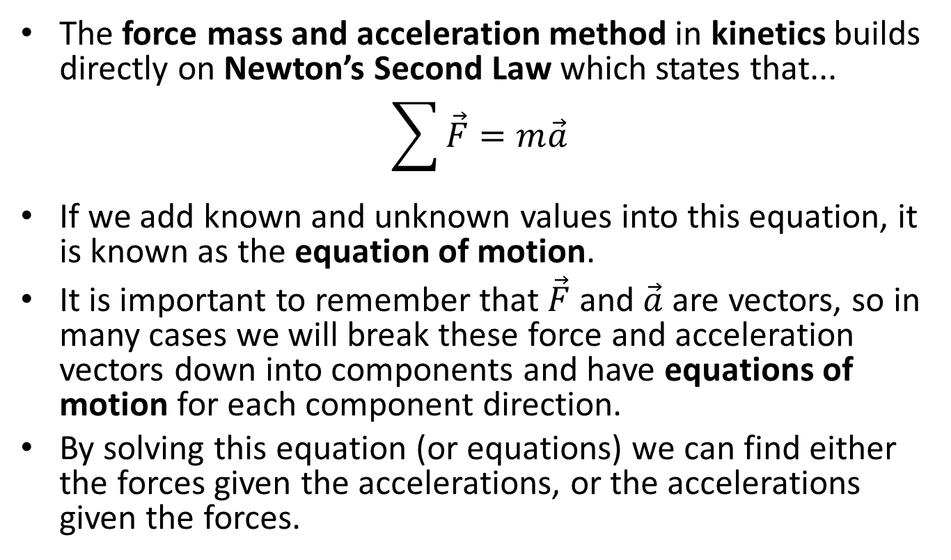
Newton’s Second Law and the Force Mass and Acceleration Method
The force mass and acceleration method in kinetics builds directly on Newton’s Second Law which states that...
$$\sum{\vec{F}}=m\vec{a}$$
If we add known and unknown values into this equation, it is known as the equation of motion.
It is important to remember that $\vec{F}$ and $\vec{a}$ are vectors, so in many cases we will break these force and acceleration vectors down into components and have equations of motion for each component direction.
By solving this equation (or equations) we can find either the forces given the accelerations, or the accelerations given the forces.

Slide 3
Force Method in Two Dimensions
Now we will have two equations of motion for normal-tangential coordinates.
$$\sum{F_{n}=ma_{n}}$$
$$\sum{F_{t}=ma_{t}}$$
Remember the normal-tangential coordinate system usually employed in instances where observations are made from the body in motion.

Slide 4

Forces in Normal and Tangential Directions
We will fill in details on the forces in each direction using a free body diagram.
It’s important break any known of unknown forces down into n and t components.
n
$$F$$
t
$$F_{n}=F\sin{θ}$$
$$θ$$
$$F_{t}=F\cos{θ}$$

Slide 5
Acceleration in Normal/Tangential Coordinates
We will fill in details on the accelerations by looking back at the kinematics
When examining the kinematics of normal tangential coordinates, we found the acceleration in normal / tangential directions to be...
$$a_{N}=v\dot{θ}=\frac{v^{2}}{ρ}$$
$$a_{t}=\dot{v}$$

Slide 6
Solving a Kinetics Problem (The Process)
The process used in solving a kinetics problem is similar to solving a problem in statics and consists of three steps.
Set up a free body diagram.
Draw the body separated from its surroundings
Draw in all the known and unknown forces (I use red for forces) as well as key dimensions and angles (I use blue for dimensions and angles)
Draw in the acceleration vector (I use a blue dashed vector for this)
Use the free body diagram to write out your equations of motion, breaking all forces and accelerations down into n and t components
These may be supplemented with kinematics equations.
Solve the equations for any unknowns.

Slide 7
Thanks for Watching
See other engineering mechanics videos and access the full tool at…

Slide 8

Kinetics with Normal Tangential Coordinates Worked Example
A 1000kg car travels over a hill constant speed of 100 km/hr. The top of the hill can be approximated as a circle with a 90 m radius.
What is the normal force the road exerts on the car?
How fast would the car have to be going to get airborne?
v = 100 km/hr
r = 90m

Slide 9
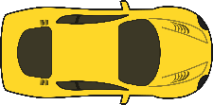
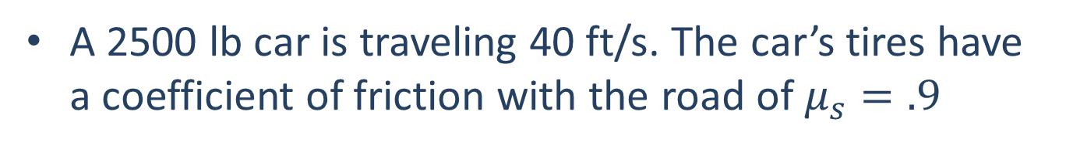
Kinetics with Normal Tangential Coordinates Worked Example
A 2500 lb car is traveling 40 ft/s. The car’s tires have a coefficient of friction with the road of $μ_{s}=.9$
Assuming the car maintains a constant speed, what is the minimum radius of curvature before slipping?
Assuming the car is speeding up at a rate of 10 ft/s², what is the minimum radius of curvature before slipping?

Slide 10
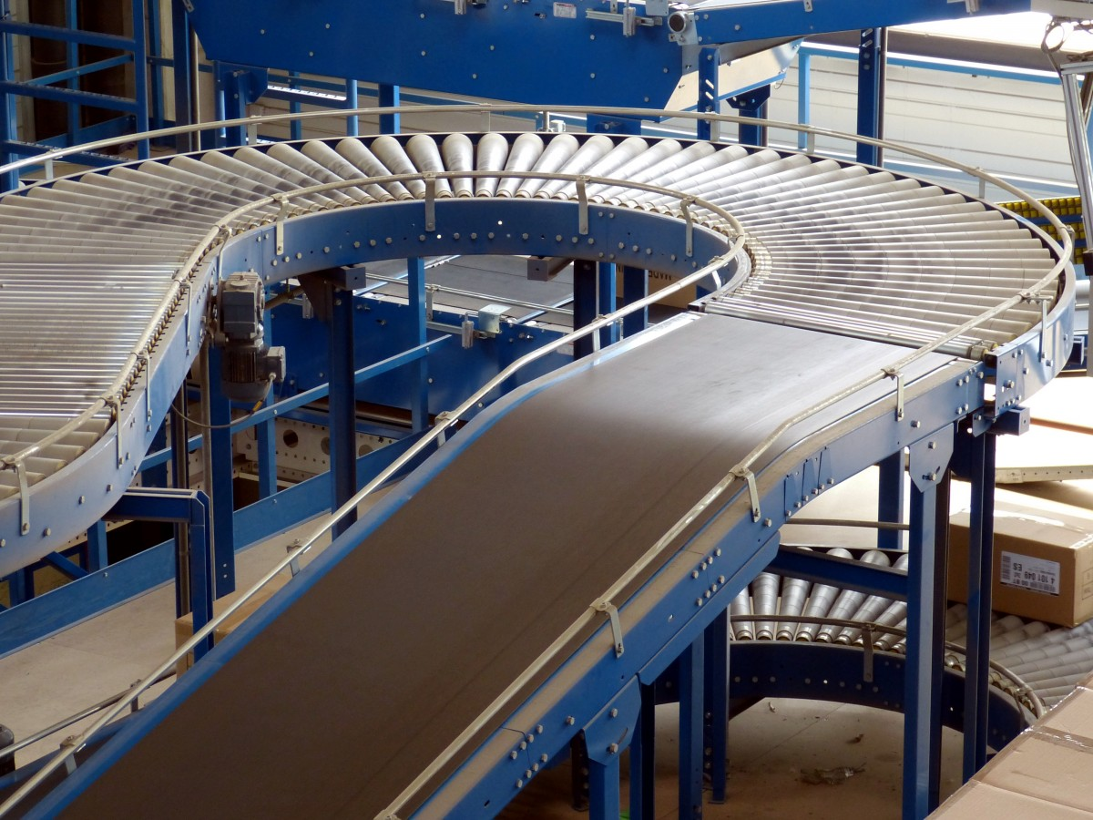
Kinetics with Normal Tangential Coordinates Practice Problem
15 kg boxes are being transported around a curve via a conveyor belt as shown to the right. Assuming the curve has a radius of 3 meters and the boxes are traveling at a constant speed of 1 meter per second. What is the minimum required coefficient of friction needed to ensure the boxes don’t slip as they travel around the curve?

